Slide 1
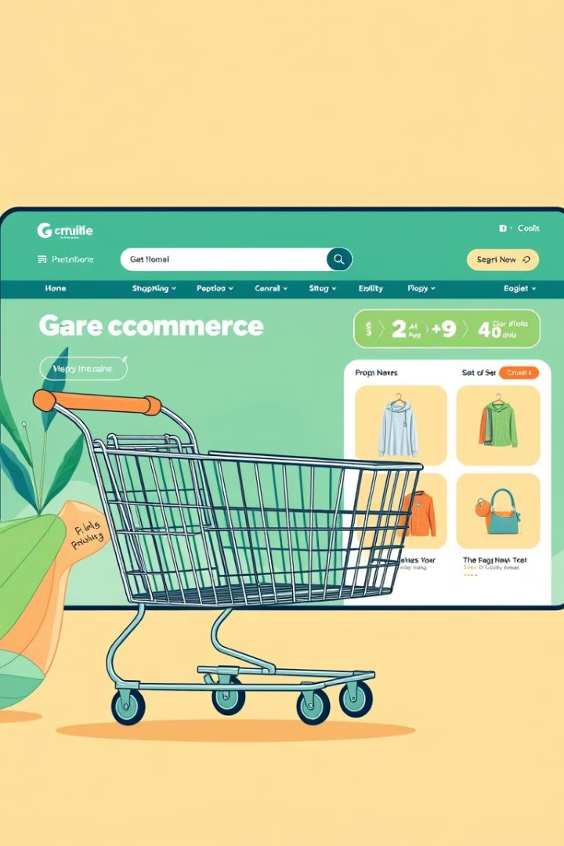

E-commerce Platform using Flask
Empowering online shopping with a seamless, user-friendly platform built on Flask.
by Anthony Ndegwa

Slide 2
Team Members
Anthony Ndegwa
Full Stack Developer
Python, Flask, Database Design, Front-end, API Development

Slide 3
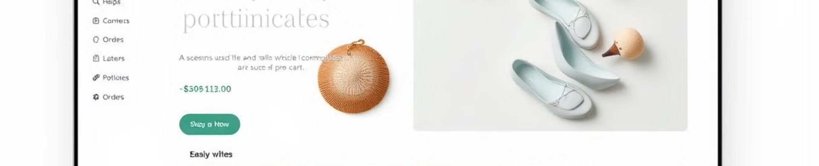
Project Description
1
Browse Products
2
Seamless Shopping
Wide range of products with rich detail pages
Add to cart, manage quantities, and checkout easily
3
Manage Accounts
4
Admin Interface
View past orders, save favorites, and more
Manage products, orders, payments, and customer data

Slide 4
Learning Objectives
Web Development
1
Flask, front-end, back-end
2
Database Design
Relational database, SQLAlchemy
Authentication and Security
3
Flask-Login, bcrypt, secure payments
4
Agile Methodology
Sprints, Trello/Kanban, iterative improvements
API Integration
5
RESTful API, third-party services

Slide 5
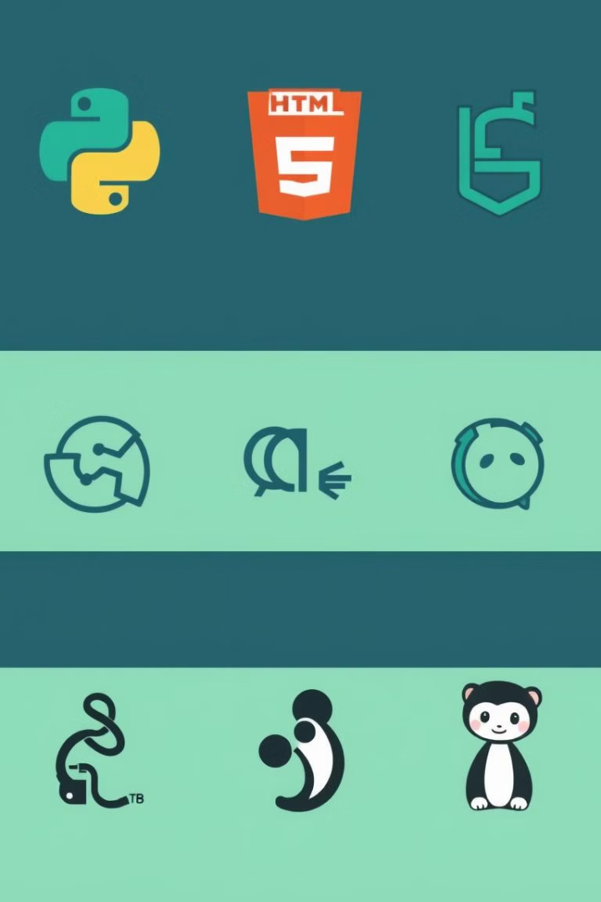




Technologies Used
Python (Flask)
Backend framework
HTML, CSS, JavaScript
Frontend development
SQLite, PostgreSQL, SQLAlchemy
Database and ORM
Git, GitHub
Version control

Slide 6

Third-Party Services
Stripe or PayPal
SendGrid or SMTP
Secure online payments
Transactional emails
Amazon S3 or Google Cloud
Google Analytics
Scalable media storage
User activity tracking

Slide 7




Challenges Identified
Scalability
Handle increasing traffic and database load
Security
Protect against attacks, secure payments
Responsive UI
Ensure seamless experience across devices

Slide 8
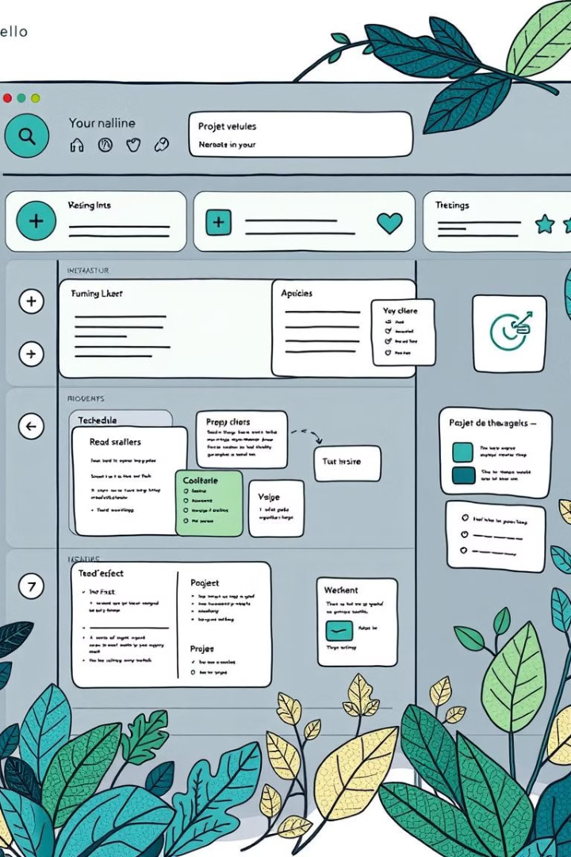
Schedule of Work
Week 1
Set up Flask, database models, authentication
Week 2
Implement product listing, shopping cart, admin panel
Week 3
Integrate payment gateway, testing, deployment
Week 4
Finalize testing, deploy to production, complete documentation

Slide 9
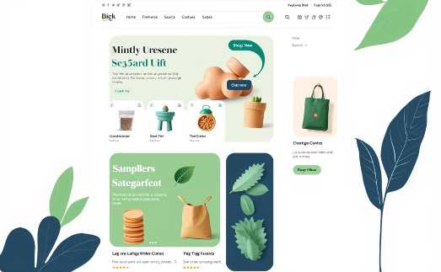
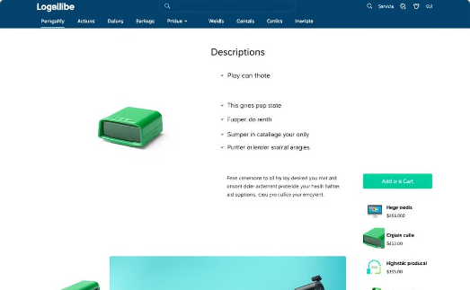
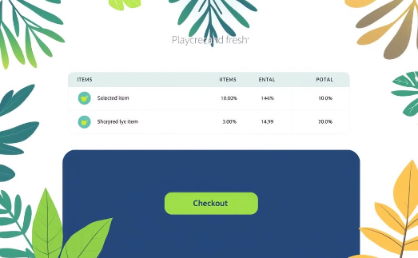
Mock-ups
Homepage
Product Details
Shopping Cart
Product listings, featured items, and banners
Detailed product information and add to cart
View cart contents and proceed to checkout

Slide 10

Thank You
Thank you for your time and attention. Looking forward to your feedback.

